Slide 1
Data Science for Nature and Conservation
Bobcat STEM Academy

Slide 2
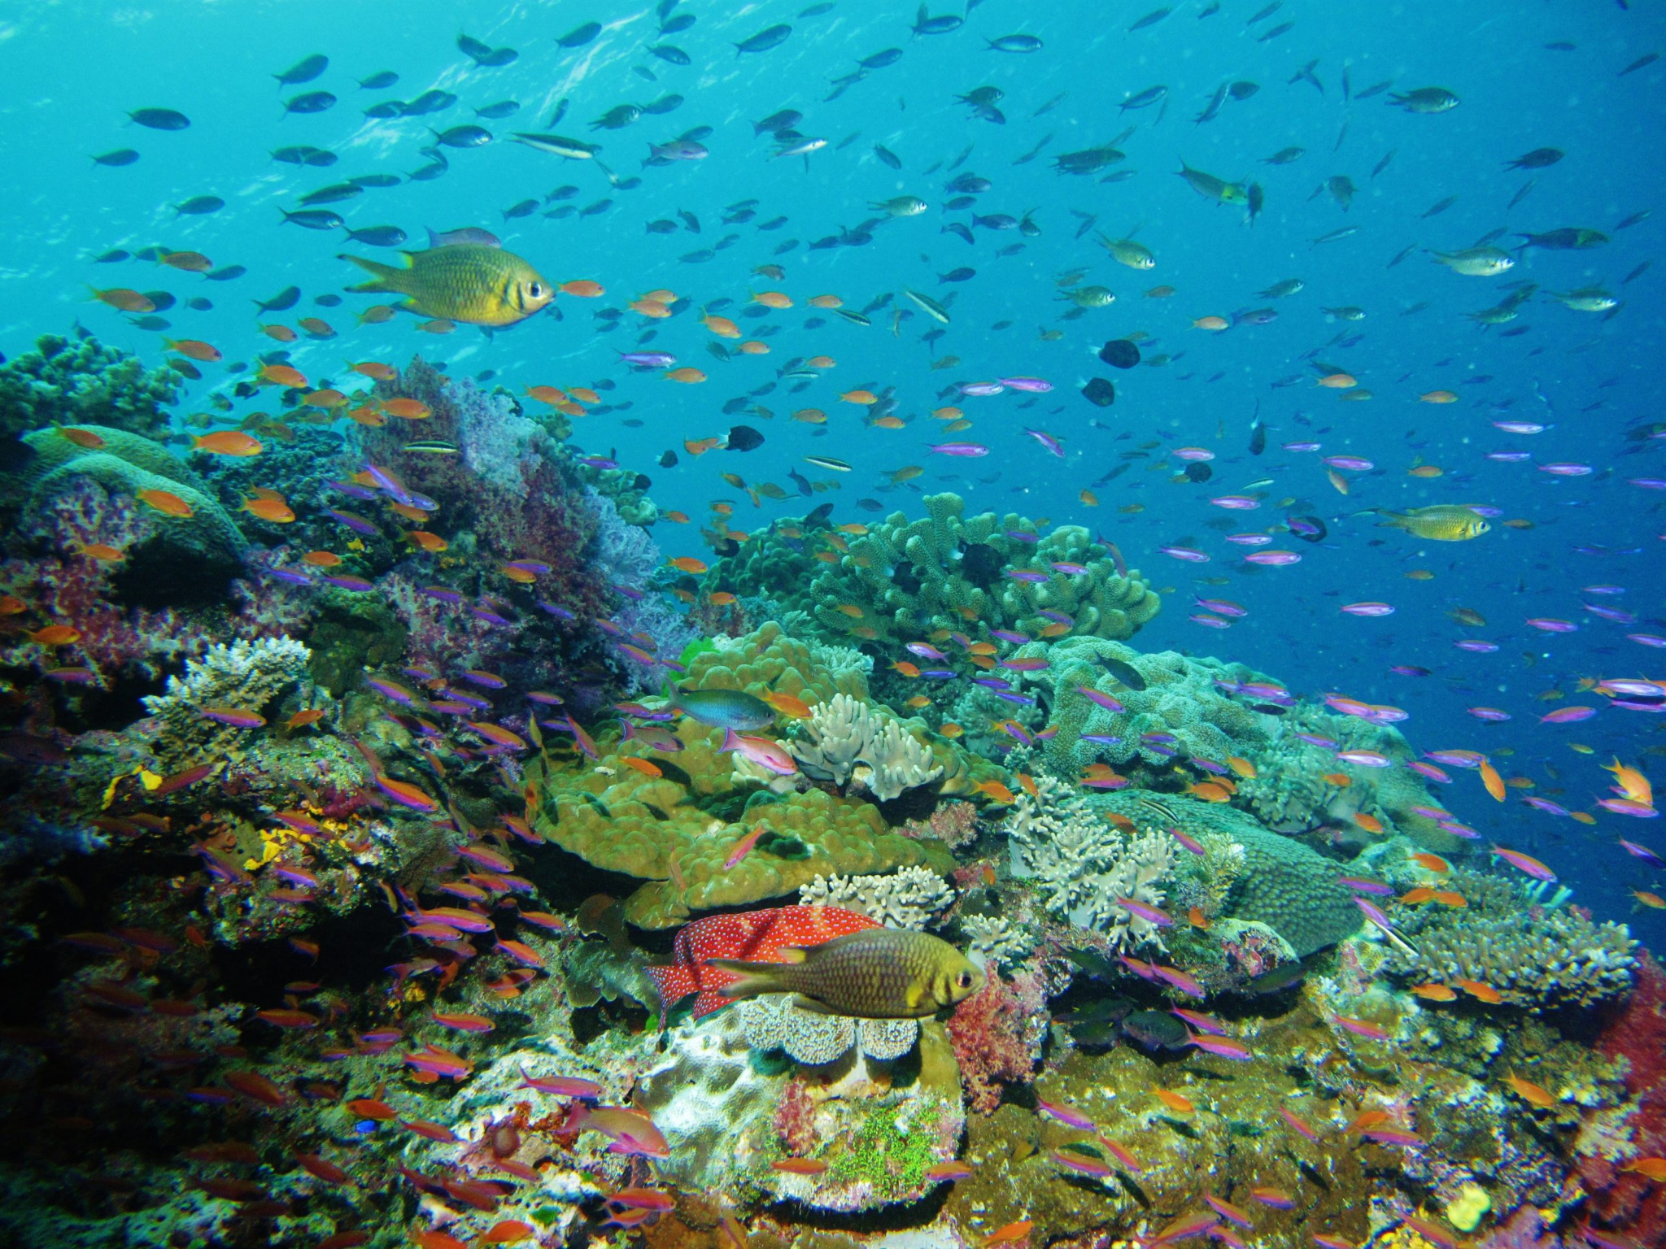
Getting Organized
Check out your computers – find the folder titled “Data Science for N&C” and open the folder.
Open up the file “course_overview.html” in your browser and follow along.
Make sure to save all your work and files into this same folder each day.

Slide 3
Day 1:
Introduction to biodiversity and data science

Slide 4
Part 1: Biodiversity and conservation
What is biodiversity?
Why does it matter?
How do we talk about it?
How do we study it?

Slide 5
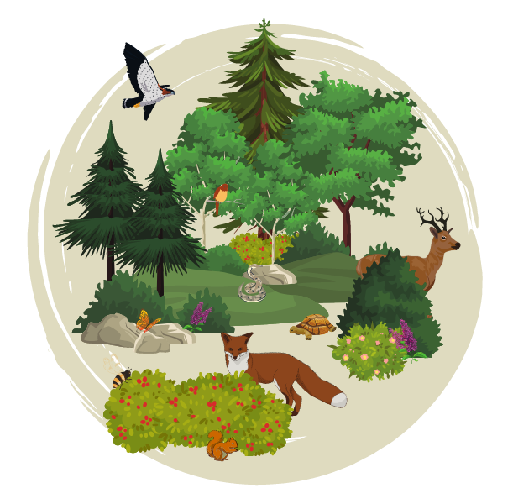
Biodiversity
Why it matters
All the variety of living things on Earth
- or -
All the living things in a single ecosystem
Ecosystems are made up of living things & their interactions
Ecosystem functions are part of Earth’s “life support system”
Humans are just as dependent on this as any other living thing
Higher biodiversity makes ecosystems more stable when conditions change

Slide 6
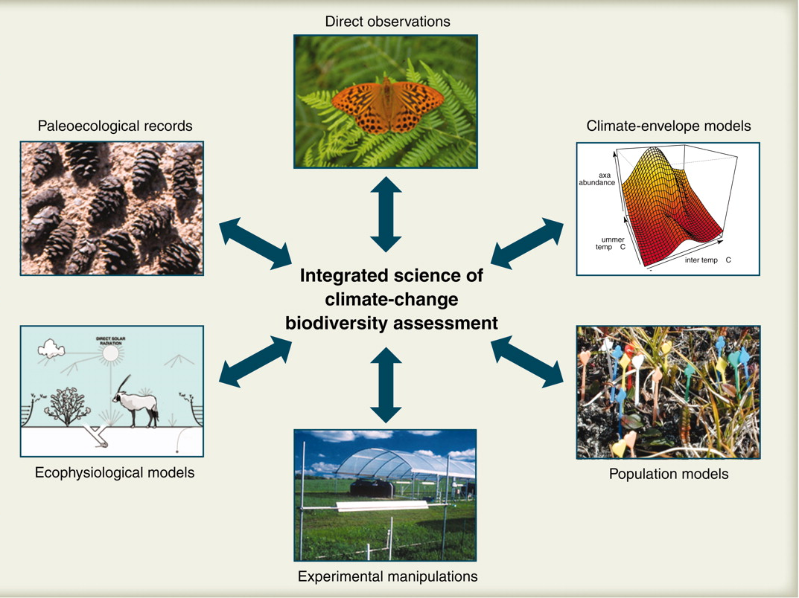
How we study it
Different kinds of data
Observations of where organisms live
Both present and past
Experiments on live organisms
How much do they eat/breathe/poop/etc?
How do they respond to changes in conditions
Different mathematical models are developed based on those data
Physiological needs
Population numbers
Climate-based niche

Slide 7
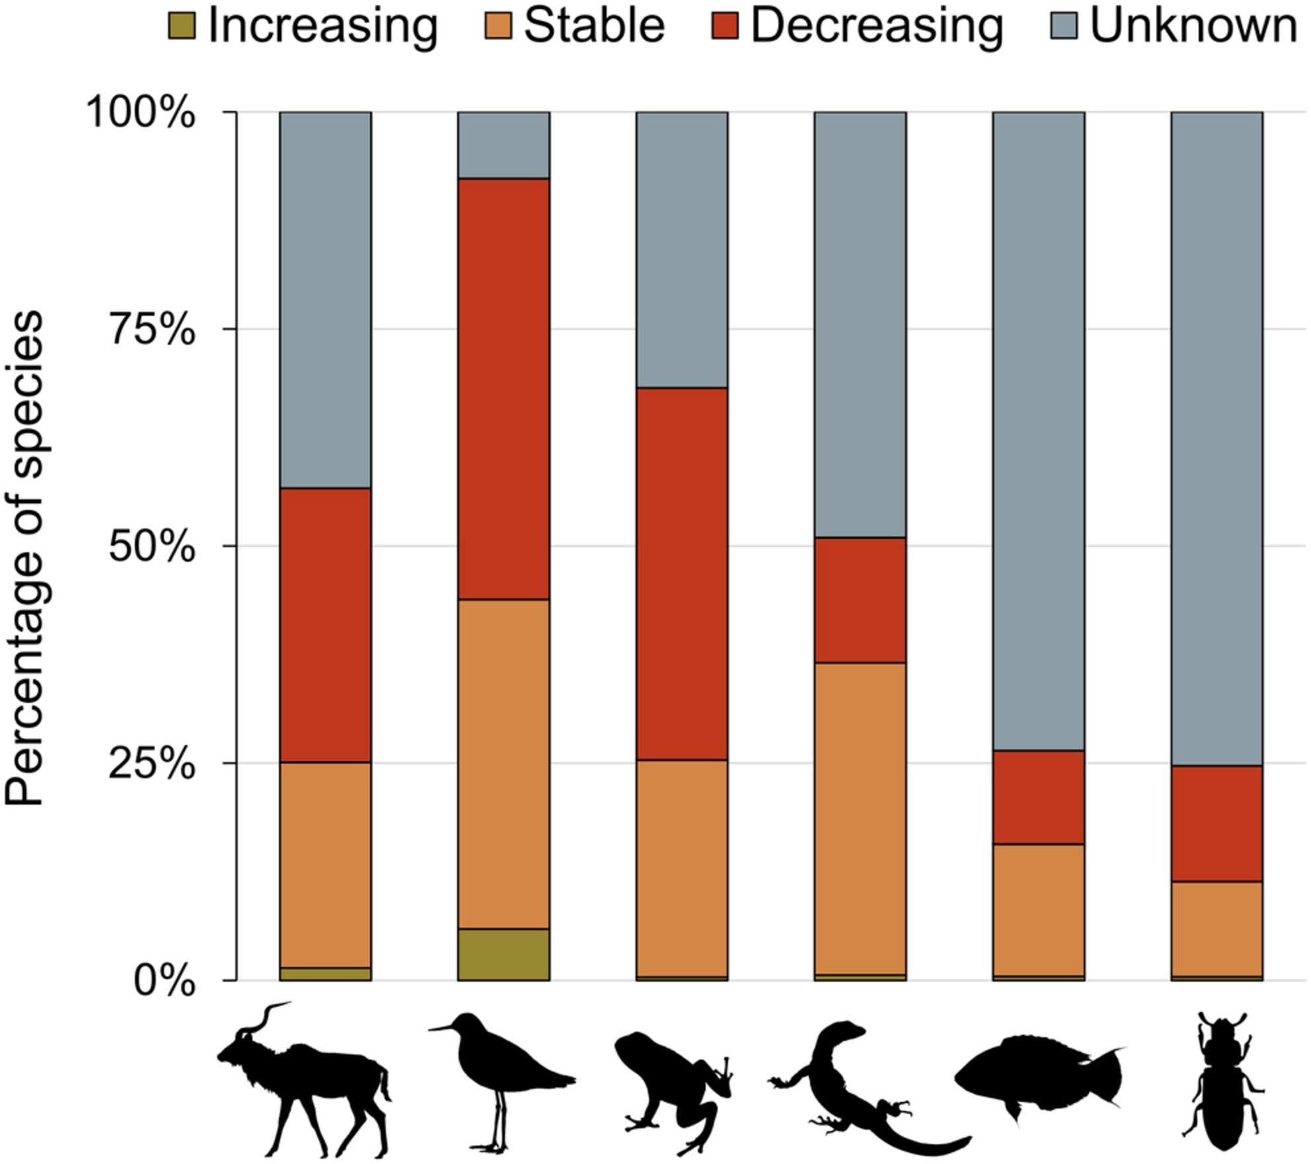
Threats to biodiversity
Extinction rates are high right now due to high rates of global change.
Loss of habitat
Direct destruction
Global warming
Changes in species interactions
Invasive species
Overhunting/overfishing
It is especially important to monitor which areas are being affected by what problems

Slide 8
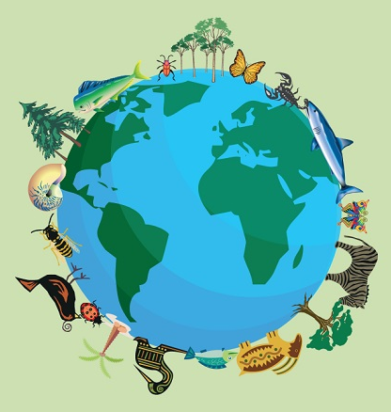
Biodiversity
Astounding diversity of life on earth at all levels:
Genetic
Individual
Ecosystem
What do we need if we want to talk about biodiversity?
Organized language!

Slide 9
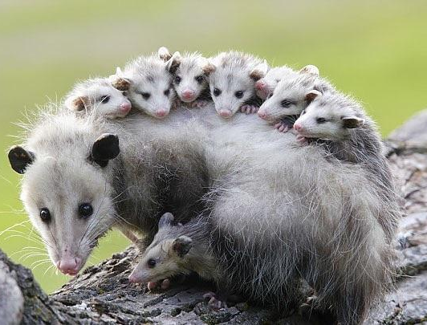
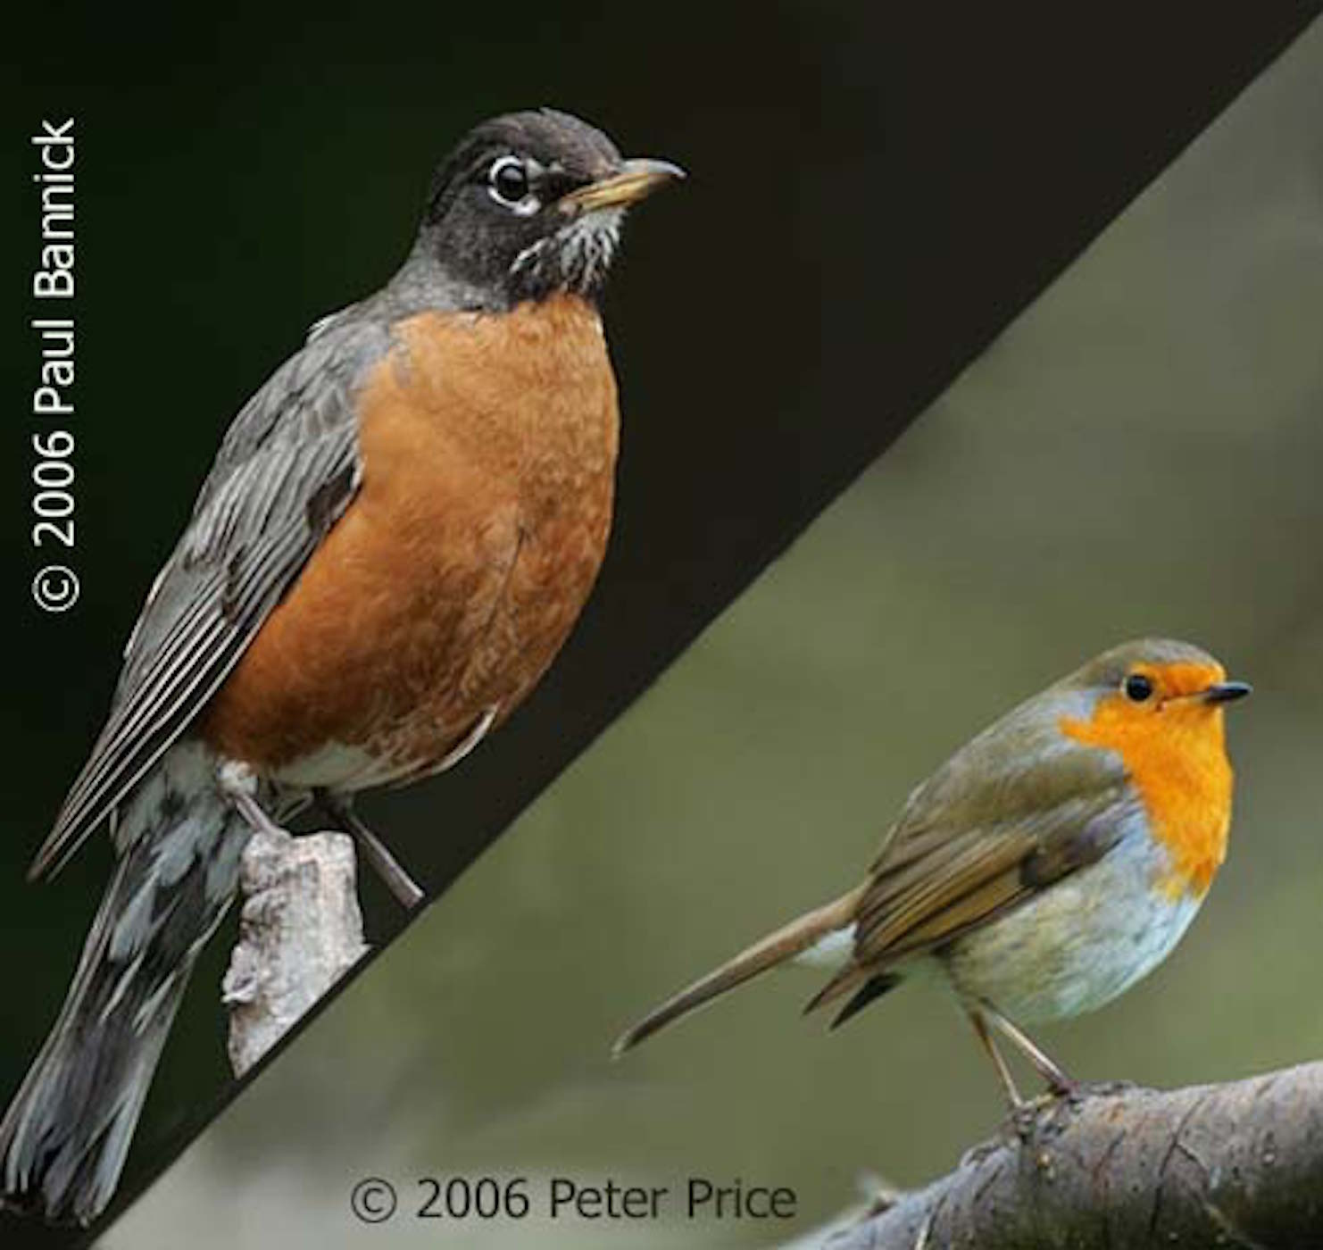
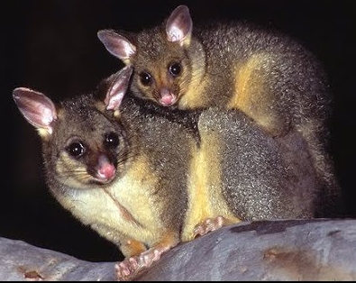
Common name problems
“robin”
“possum”

Slide 10
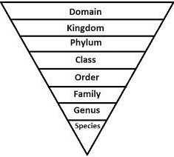
Scientific (Linnaean) taxonomy
It groups organisms by ranks, which are like a series of nested boxes (taxa) that decrease in size (encompassing fewer individual organisms) as you get more specific.
Every organism belongs to a species, every species to a genus, every genus to a family, and so on up the hierarchy.

Slide 11
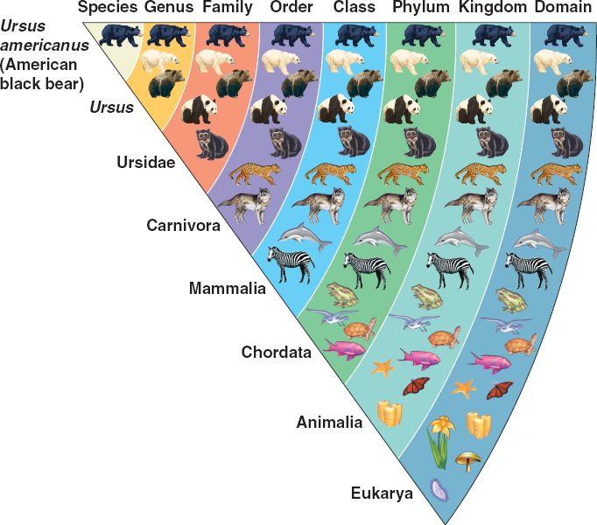
Binomials
The smallest two taxa, “genus” and “species”, are the ones that make up the scientific name.
You have to use both:
Ursus americanus

Slide 12
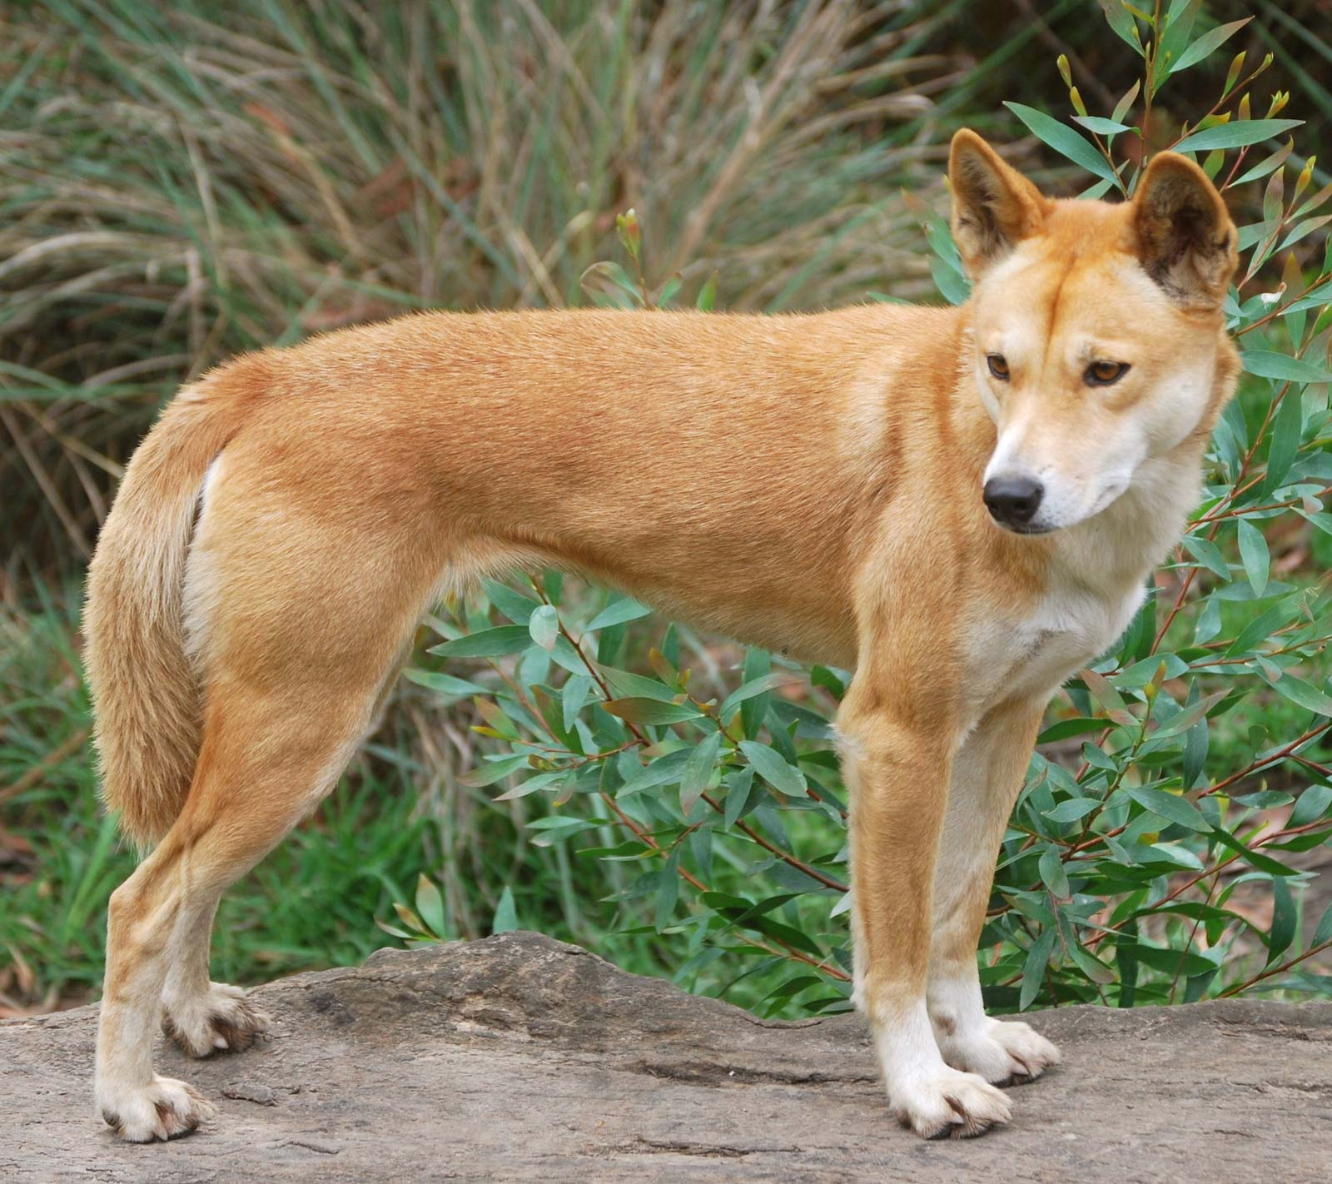
Binomial nomenclature
Genus name typically applies to several species:
Canis, genus of dogs/wolves/etc.
Canis lupus (wolves and domestic dogs)
C. latrans (coyotes)
C. dirus (extinct dire wolves)
...and several more species...
Scientists all use the same binomial name for the same species, regardless of language. This decreases the confusion of common names.

Slide 13
Universal scientific names
Turdus migratorius
Didelphis virginiana
Erithacus rubecula
Trichosurus vulpecula

Slide 14
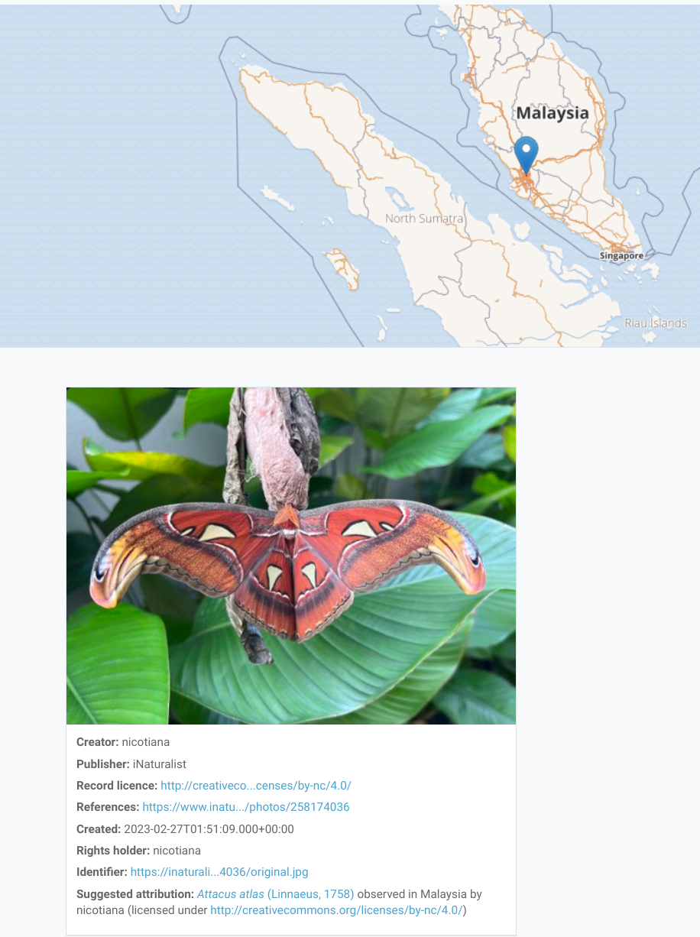
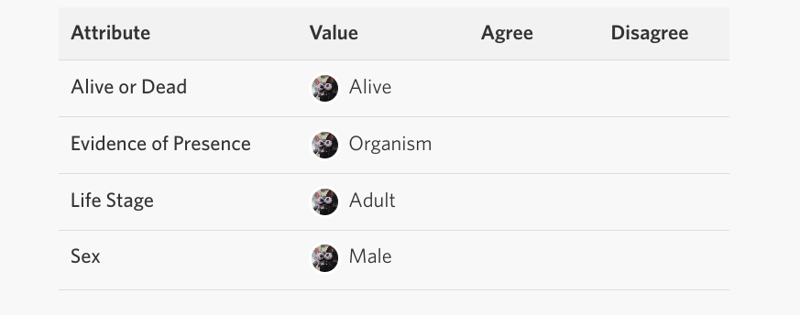
Biodiversity data
Course focus: species occurrence data.
What’s the organism?
Where & when was it seen?
What else do we know about it?

Slide 15

Part 2:
Data science
What is data science?
What tools do we use to do it?
How do we use it to study biodiversity?

Slide 16
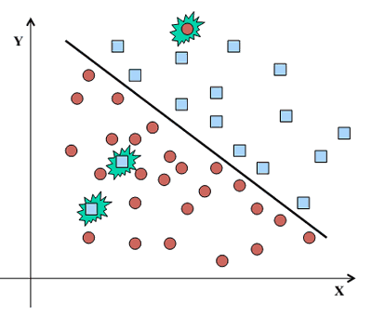
“Data science”: getting info from big messy data
While there are aspects of science to ‘data science’, it’s more often thought of as a set of methods used in all sorts of different fields…
Natural sciences
Social sciences
Many non-science-related things
What all of them have in common:
Large amounts of information (data)
Often messy and full of errors
Statistical methods for refining it into system understanding
Programming techniques for dealing with lots of it quickly

Slide 17
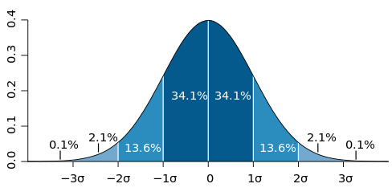
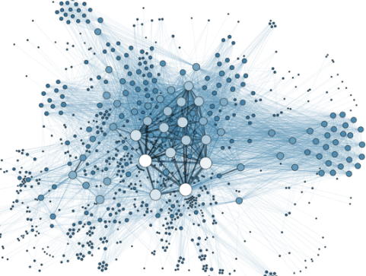
First there was statistics, now there’s data science
Statistics:
Analysis of quantitative information
Subfield of applied mathematics
Can be done without computers
Good, carefully-collected data
More precise conclusions
Data science:
Analysis of quantitative information
Relatively simple statistical methods
Computers absolutely required
Large volumes of poorly-collected data
Less precise but can be more flexible

Slide 18
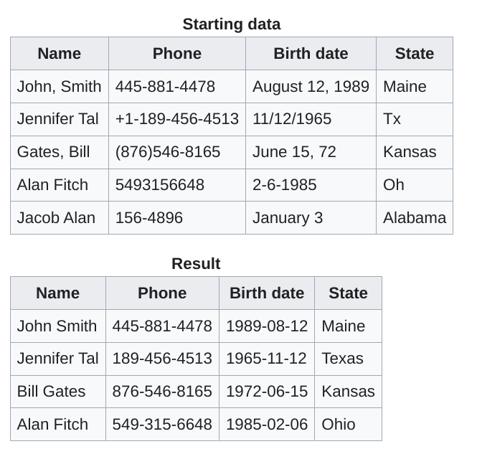
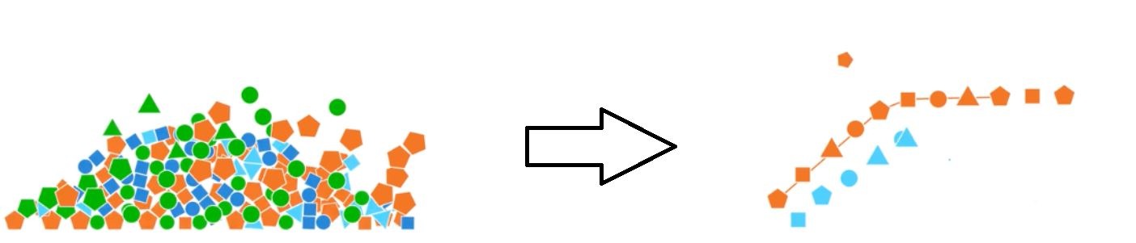
Cleaning messy data
A big part of data science is dealing with data that is ‘messy’
Often crowdsourced or even machine-collected data
More data = more potential for error
Regrettably very hard to automate

Slide 19
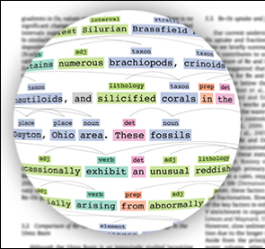
Analyzing large volumes of data
Extracting patterns that might not be obvious
Avoiding bias & finding only what’s there
“Data mining”
Simple statistical methods applied to very large data sets
Machine learning algorithms
Includes “AI”/”deep learning”
Not covered in this class, we can’t get there in 2 days
“Big data” – typically MUCH larger datasets than we’ll deal with here!
E.g. “all the science papers ever published”
Or “every picture of a plant on Instagram”

Slide 20
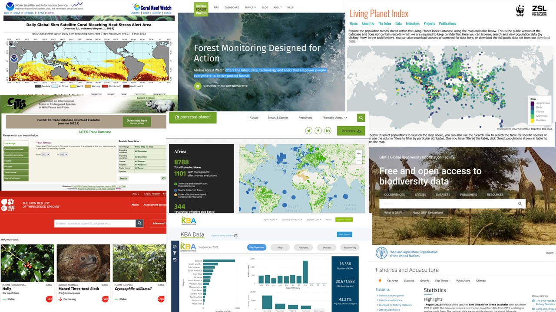
Ecology/environmental science databases
Many groups of ecologists, evolutionary biologists, environmental scientists, etc.
Many specialized public databases
Allows us to do all kinds of interesting new science…

Slide 21
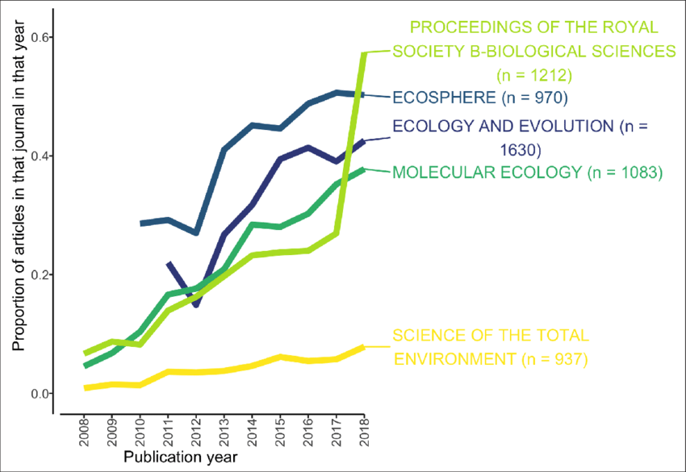
Programming basics for this class
Programming language: R
- (ecologists like R!)
Development environment: RStudio
Packages:
dismo (species distribution modeling)
raster (spatial image data processing)

Slide 22
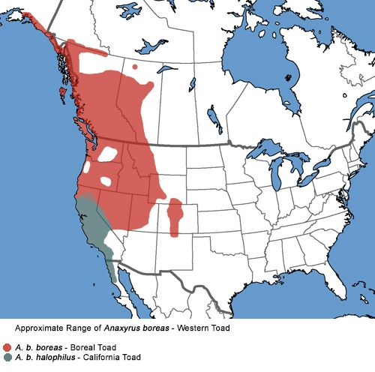
Part 3:
Species range maps
What does a species range map look like?
How do you make one?

Slide 23
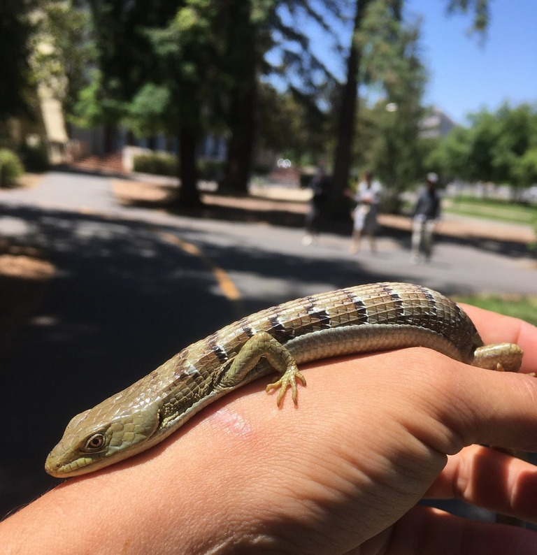
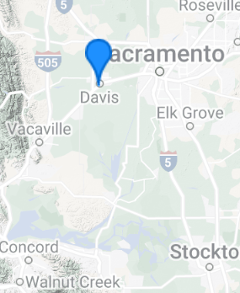
Observations (made by anyone)
So I met this lizard the other day…
(Behavior: very mellow; maybe he was cold or just molted?)
LOCATION: bike path on UC Davis campus by the arboretum
SPECIES: California alligator lizard, Elgaria multicarinata ssp. multicarinata

Slide 24
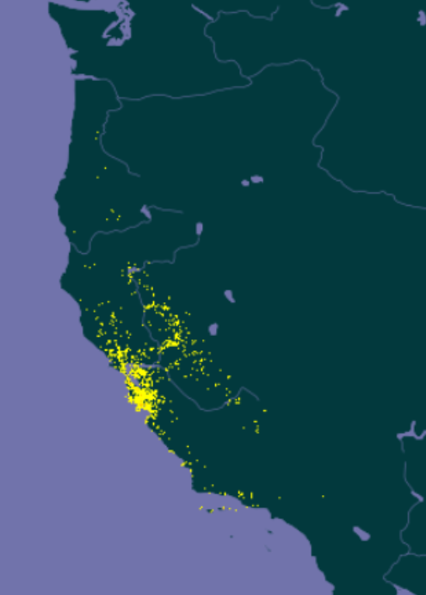
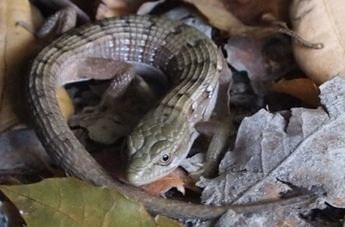
Species occurrences
Collect a list of places (GPS coordinates) where a particular species has been seen.
Sightings of live specimen
Traces (nests, dung, etc)
Collections (live or dead)
Fossils are a special case for tomorrow
Plot each of them as a point on a map, and you have some idea where they live. (In this case that’s basically Oregon and California.)
This is the map auto-generated from GBIF, which you have already seen.
Elgaria multicarinata ssp. multicarinata
(California alligator lizard)

Slide 25
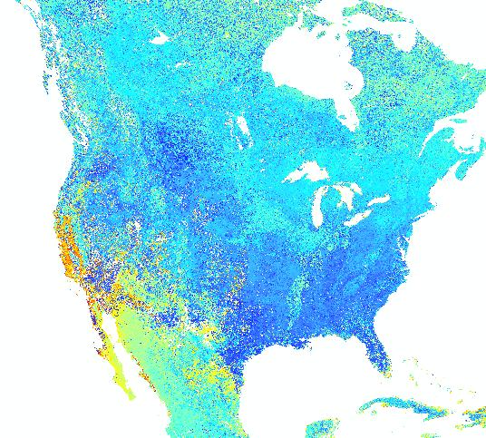
Lots of dots
Just the species observation dots makes a pretty interesting map by itself!
(right: North American species map, from USGS)
But what can we say about the areas between the dots?

Slide 26
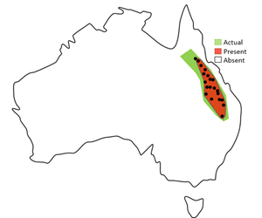
How about…drawing a line around all the dots?
“Concave hull”: line that encircles all the localities
“Convex hull”: same thing but it’s not allowed to be concave anywhere
Always an underestimate either way
Not the most accurate way to estimate species range, but definitely the easiest!

Slide 27
Part 4:
Visualizing species niches
How do environmental factors affect species ranges?
Can we answer those questions using spatial data?

Slide 28
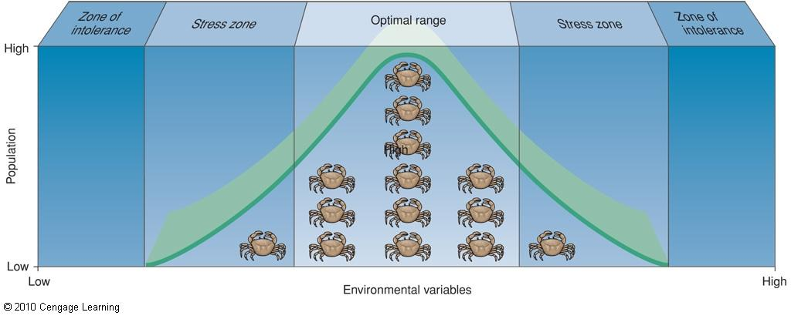
Species environmental preferences
Applies to any variable (sunlight, water, pathogen load...)

Slide 29
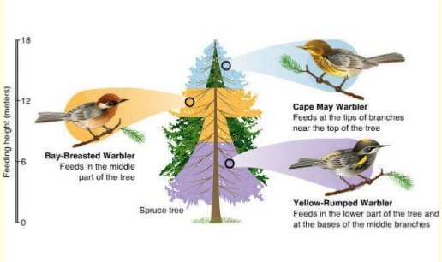
Niche: what exactly does the animal do?
“Place” in the ecosystem: i.e. specific environment preference.
Food source, habitat, behavior, etc.

Slide 30
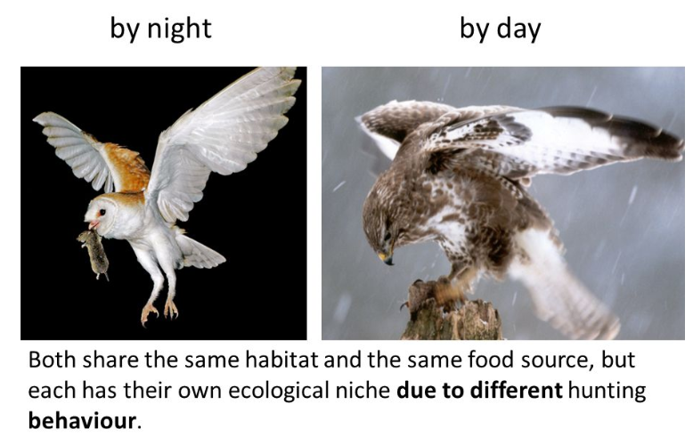

Slide 31
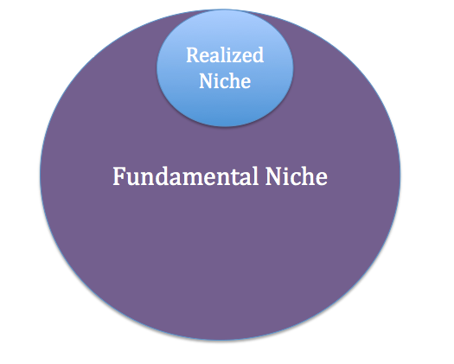
How do we know where they might live?
Every species has a niche in its ecosystem.
Abiotic conditions
Temperature, water, soil type, etc.
Interactions with other organisms
Prey, predators, symbionts, etc.
Role or function in its ecosystem
How it affects other organisms
How it affects the abiotic environment
If all the right conditions are present, that species could live there. This set of conditions is called its fundamental niche.
The realized niche is where it actually does live.

Slide 32
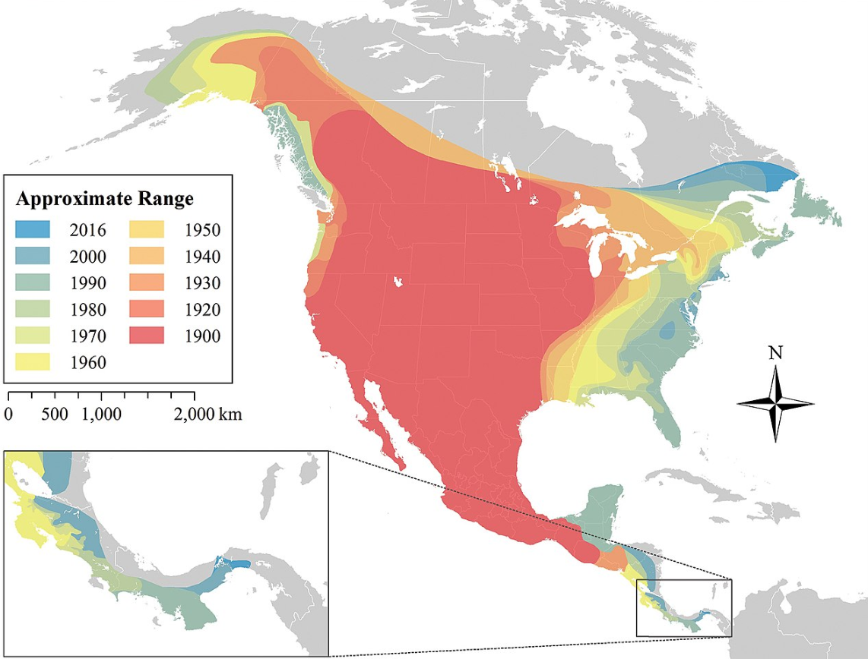
Expansion of realized niche
Realized niche can expand when things change.
Coyotes’ main competition was red wolves, which are mostly extinct

Slide 33
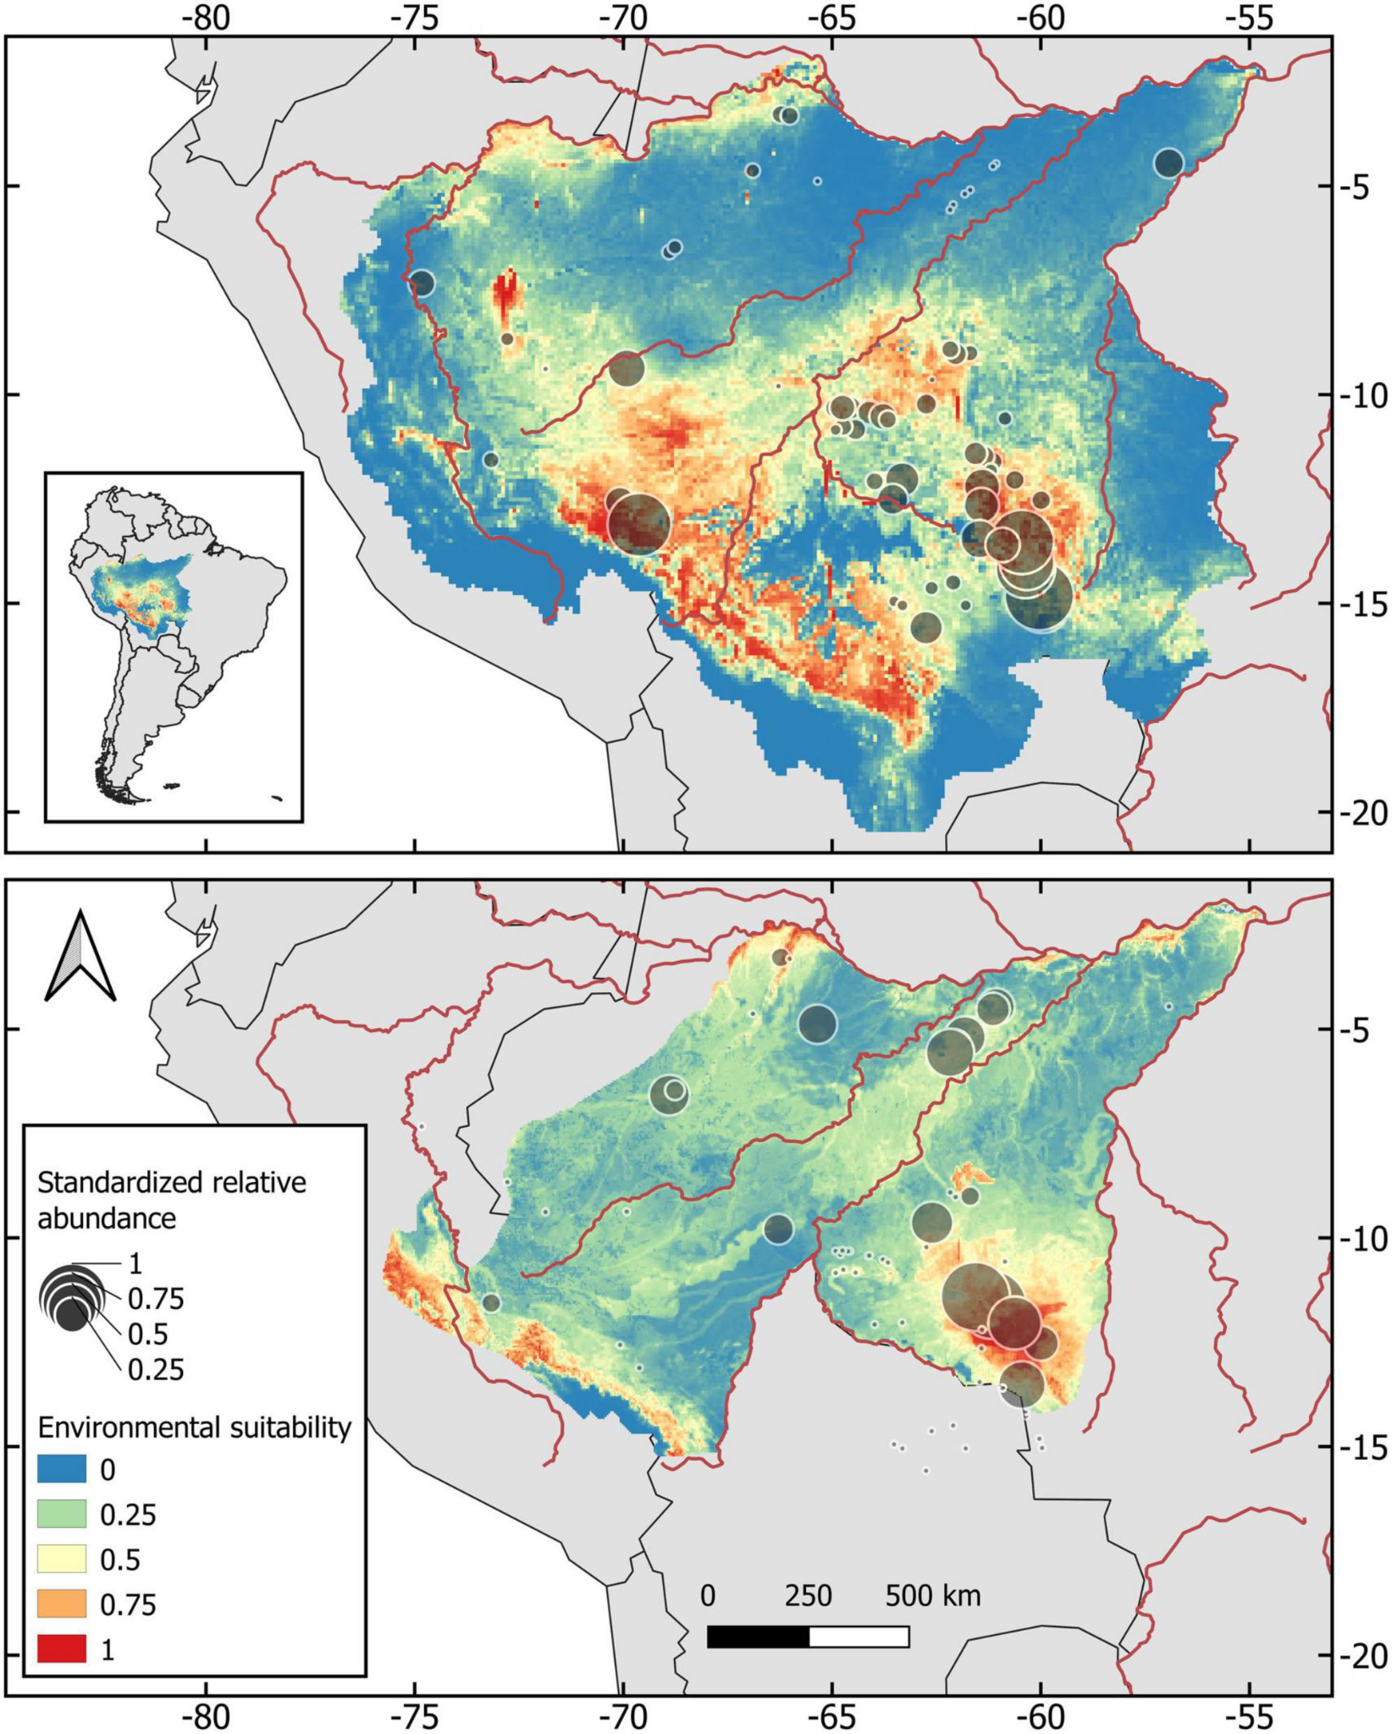
Mapping species niche using environmental data
Species distribution data
+
Environmental data: rainfall, temperature, etc.
=
Suitable habitat
Today we’ll just map the environmental data.
Tomorrow we’ll model habitat suitability.

Slide 34
Day 2:
Modeling climate change and range shifts

Slide 35
Part 5:
Environmental change

Slide 36
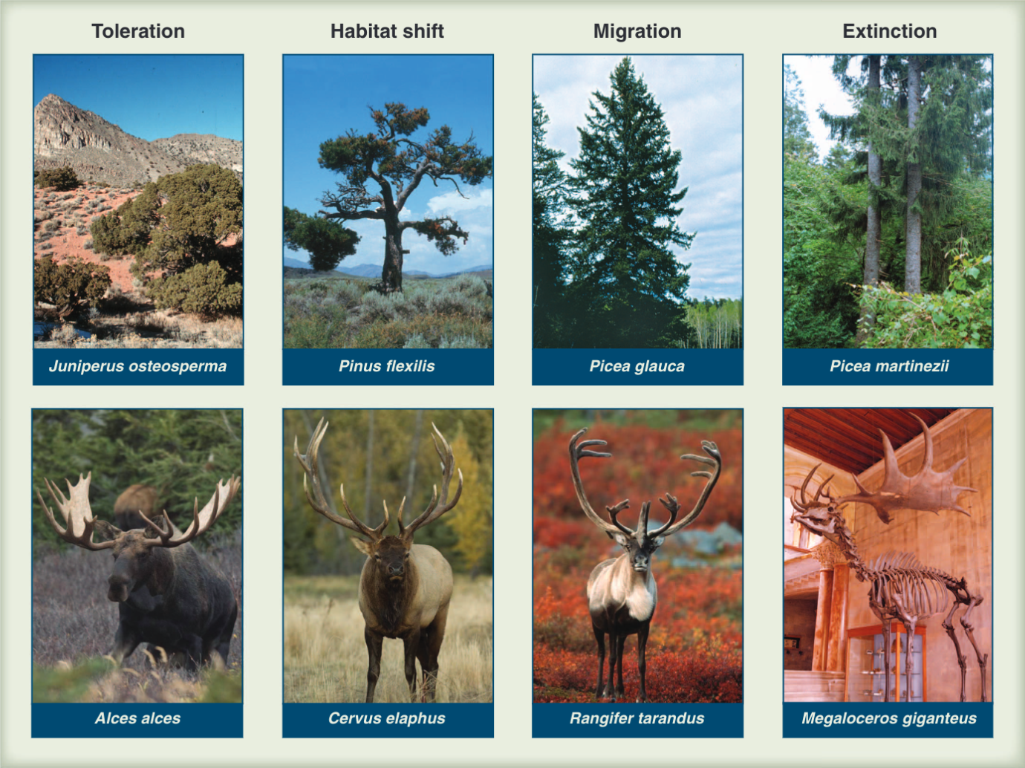

Slide 37
Part 6: Past and present species ranges

Slide 38
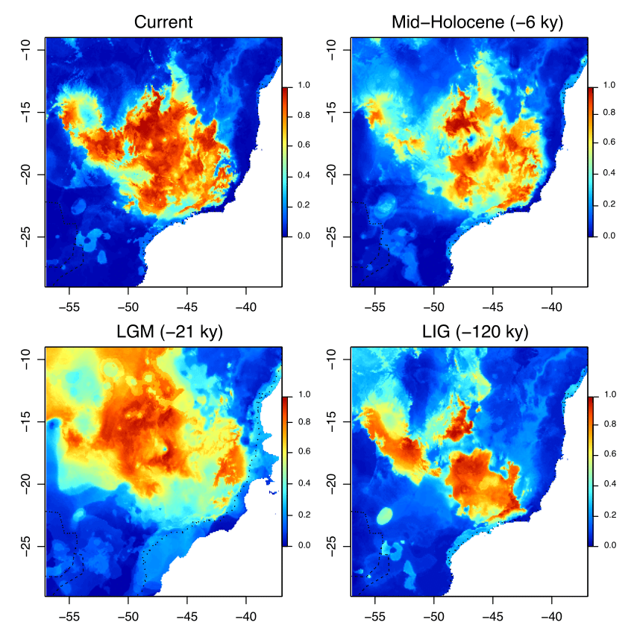
Part 7:
Making models and predictions

